Slide 1
The Healthcare Sector: Evolution from Blackbox Models to SHAP and LIME in Explainable AI
-Ritvik Chawla, Section VI E
Registration Number: 209301056
Under the guidance of: Dr Rishi Gupta

Slide 2
Purpose of underrating this topic
Interested in Machine Learning, Data Science and Artificial Intelligence, learning and exploring these domains since my fresher year at MUJ and I feel I can research more in these fields through this opportunity in my 6th-semester minor project.
A major industry where explainable AI is being applied today is the healthcare sector, extensive research is being done for finding and refining techniques with more explainability.
want to research this domain since I have the skillset required to understand the practical functionalities of the explainable AI models and what could lie ahead.
This will help me access further opportunities in the domain of explainable AI and will get me to explore the ongoing advancements in the medical sector since in the coming time, the health index will play a major role to check any community or nation’s development.
Wherever people are healthy, there will be progress and to meet such standards, technology needs to advance. Therefore, explainable AI and its toolkits will play an enormous role in the rising development of such standards.

Slide 3
Problem Statement
The problem we are trying to address through this minor project is so understand the reason why models like SHAP and LIME which are the focal points of explainable AI give greater efficiency in predicting outcomes in the health sector for several applications compared to black box models of before.

Slide 4
What is Explainable AI?
Explainable artificial intelligence (XAI) is a set of processes and methods that allows human users to comprehend and trust the results and output created by machine learning algorithms. Explainable AI is used to describe an AI model, its expected impact and potential biases. It helps characterize model accuracy, fairness, transparency and outcomes in AI-powered decision making. Explainable AI is crucial for an organization in building trust and confidence when putting AI models into production. AI explainability also helps an organization adopt a responsible approach to AI development.
What are black box models?

Slide 5
What is SHAP?
SHAP values (SHapley Additive exPlanations) is a method based on cooperative game theory and used to increase transparency and interpretability of machine learning models.
Linear models, for example, can use their coefficients as a metric for the overall importance of each feature, but they are scaled with the scale of the variable itself, which might lead to distortions and misinterpretations. Also, the coefficient cannot account for the local importance of the feature, and how it changes with lower or higher values. The same can be said for feature importances of tree-based models, and this is why SHAP is useful for interpretability of models.
Important: while SHAP shows the contribution or the importance of each feature on the prediction of the model, it does not evaluate the quality of the prediction itself.

Slide 6
What is LIME?
LIME, or Local Interpretable Model-Agnostic Explanations, is an algorithm that can explain the predictions of any classifier or regressor in a faithful way, by approximating it locally with an interpretable model.

Slide 7
Research Objectives
Explaining the several domains in which XAI models and systems can be included making the models noticeable.
Discuss the different systems, such as explainable models based on LIME and SHAP.
Talk about the many toolkits that are offered to make the model explainable under different explainable variables.
Present the numerous explainability categories connected to the decision models in intricate detail.
The study would be easier to understand as healthcare-related case studies and statistical analyses are presented.

Slide 8
Methodology and Framework
1) System Architecture
Google Colab/ Jupyter Notebooks/ Kaggle
2) Algorithms, Techniques etc
Numpy, Pandas, Seaborn, Matplotlib, Sklearn, catboost, shap, etc

Slide 9
Work
Relevant articles were searched on various sources on the internet.
Took out appropriate and relevant content which can help explain the problem statement.
Explainability on a local vs. global scale, agnostic and model-specific models, XAI model characteristics, locally interpretable and model-independent justifications, Additive explanations by Shapley, frameworks, and toolkits, etc.
Using GitHub, found medical data on medical fraud detection

Slide 10
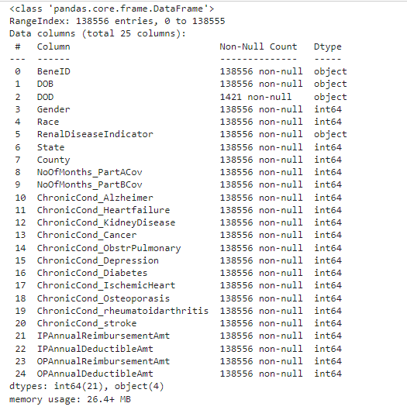
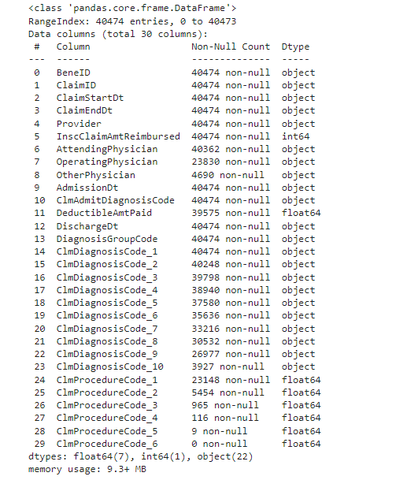
Beneficiary data(Left) || Inpatient and Outpatient data(Right)

Slide 11
Perform data cleaning, data mining, exploratory data analysis (EDA), pre-processing, feature engineering, balancing the data, and model building using the SHAP library in the catboost module to show the enhanced prediction percentage result of SHAP compared to black box models.
Compare the accuracy of various algorithms and constantly upload work on GitHub to keep the progress saved.
https://github.com/Ritvik10/Evolution-from-Blackbox-models-to-LIME-and-SHAP-in-explainable-AI

Slide 12
Future Plan
LIME-based model implementation and recording of the observations and accuracies.
Look into more research papers for more relevant content to put in the project.

Slide 13
References
[1] Parvathaneni Naga Srinivasu , 1N. Sandhya , 1RutvijH. Jhaveri , 2 and Roshani Raut 13 June 2022 “From Blackbox to Explainable AI in Healthcare: Existing Tools and Case Studies”
[2] 1,2 Ugochukwu Onwudebelu 1LIPN, Université Sorbonne Paris Nord, 99, avenue jeanbaptiste clément, 93430 Villetaneuse, Paris & 2Department of Computer Science Alex-Ekwueme Federal University of Ndufu-Alike Ikwo (AE-FUNAI), Abakaliki Ebonyi State, Nigeria, September 2021 “The Third Wave of AI: Fraud Detection via Knowledge Graphs within Explainable AI”
[3] SERHIY KANDUL, University of Zurich, Switzerland VINCENT MICHELI, University of Geneva, Switzerland JULIANE BECK, University of St. Gallen, Switzerland MARKUS KNEER, University of Zurich, Switzerland THOMAS BURRI, University of St. Gallen, Switzerland FRANÇOIS FLEURET, University of Geneva, Switzerland MARKUS CHRISTEN, University of Zurich, Switzerland, January 2023, “Explainable AI: A review of the empirical literature”
[4] Dr. Tom Kraus Lene Ganschow Marlene Eisenträger Dr. Steffen Wischmann, April 2022, “Explainable AI - Requirements, Use Cases and Solutions”
[5] dancor7- GitHub account, July 22, 2020, https://github.com/dancor7/Medical_Fraud_Detection_With_SHAP_Values/blob/master/data.rar

